Slide 1
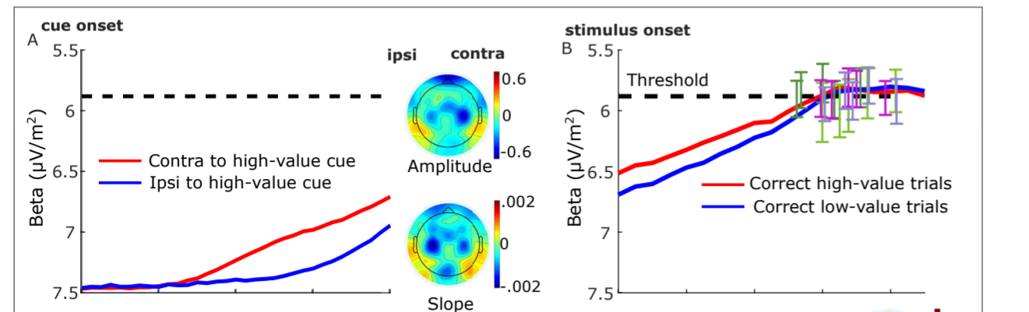
MB update 23/July/2024
Update MB baseline (f-domain)
Update Triger delay 60-70ms
Different baseline for diff condition????
SL- just before stimuli (-188)
RL-just before resp.

Slide 2
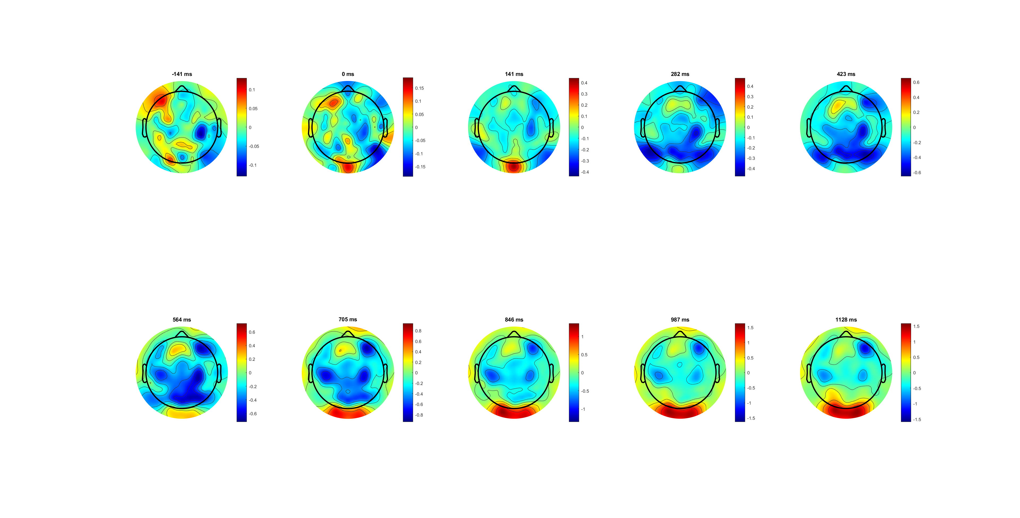
Left only Correct (dymic limit)

Slide 3
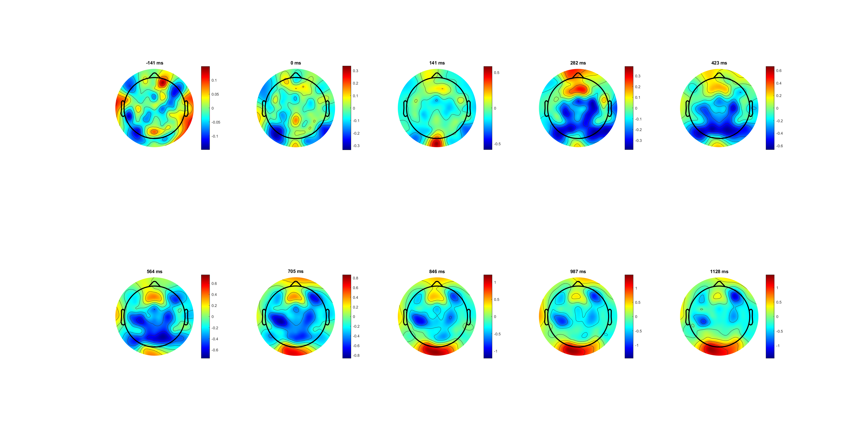
Right only correct

Slide 4
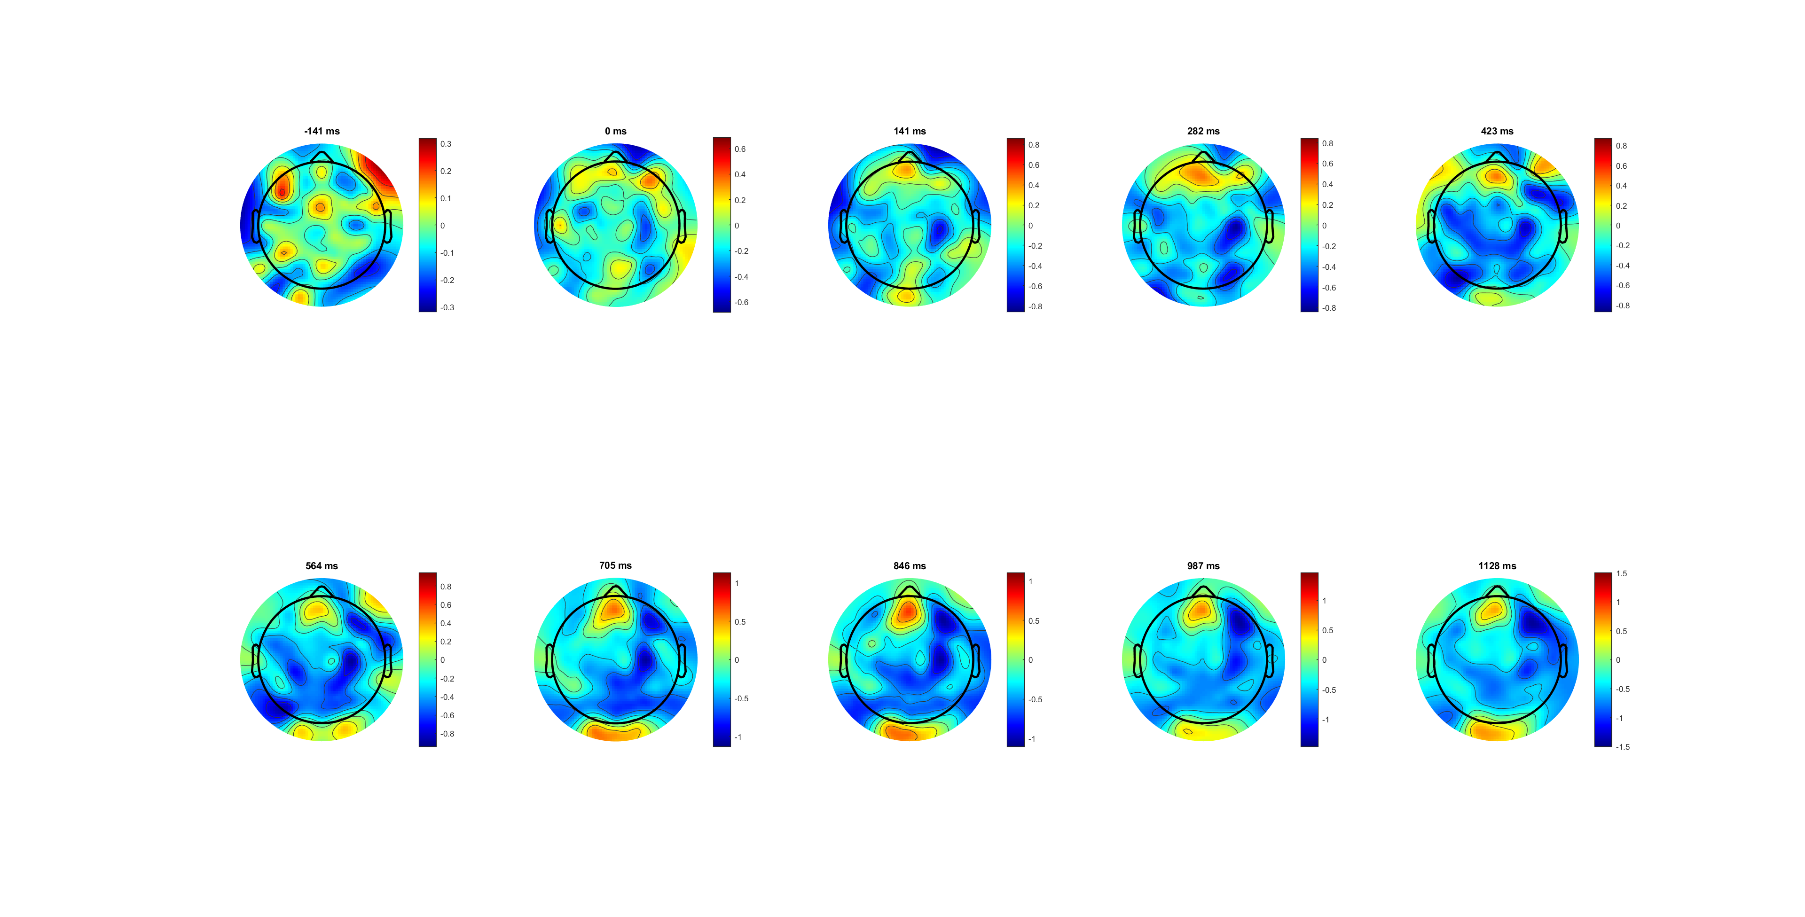
Left only wrong

Slide 5
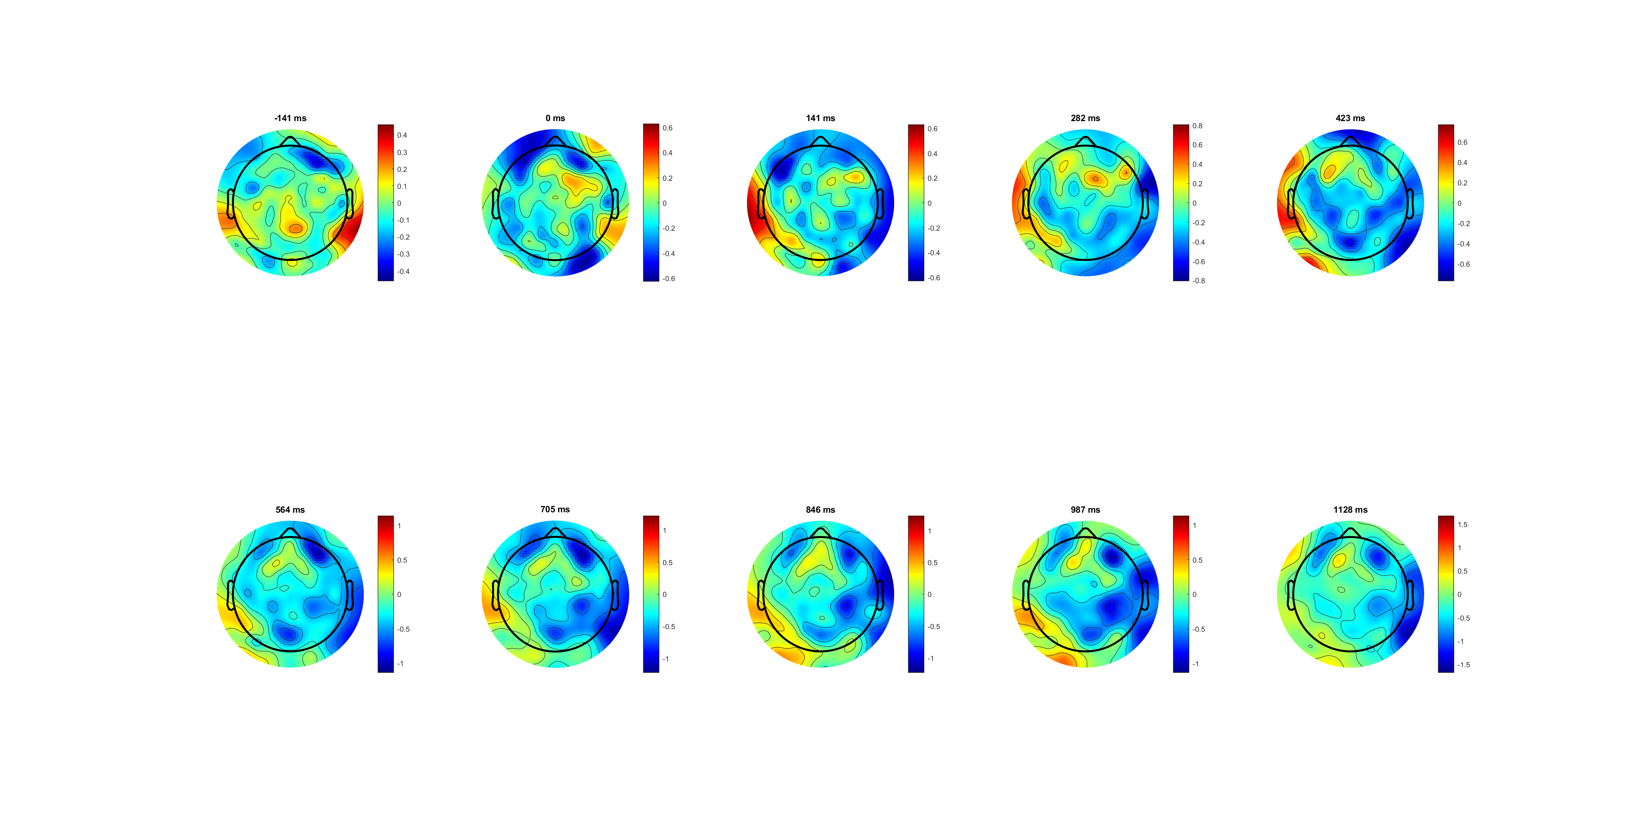
Right only wrong

Slide 6
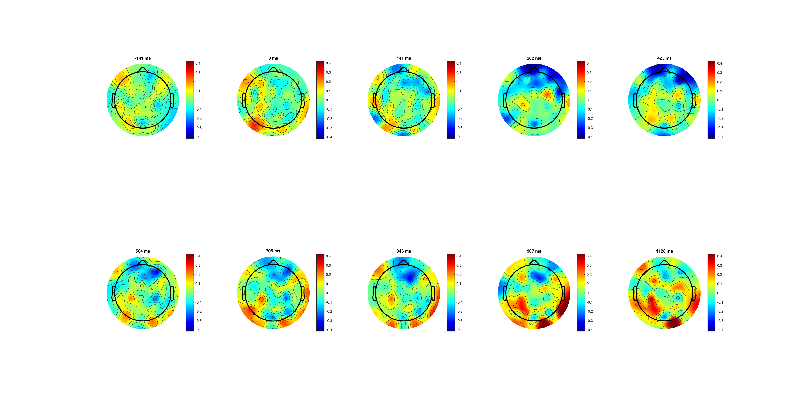
Correct lateralisation (L-R) 0.4limit
amplitude is lower contralateral to the button that was pressed

Slide 7
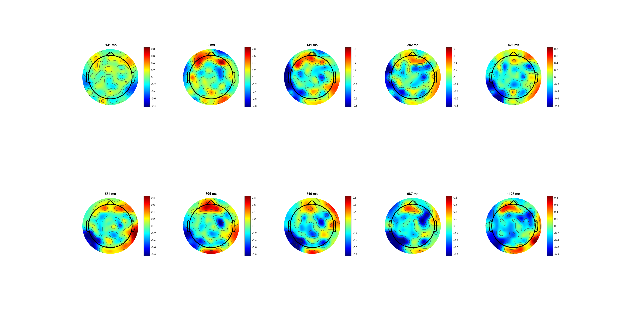
Wrong lateralisation (L-R) 0.8lim

Slide 8
Add average baseline?

Slide 9
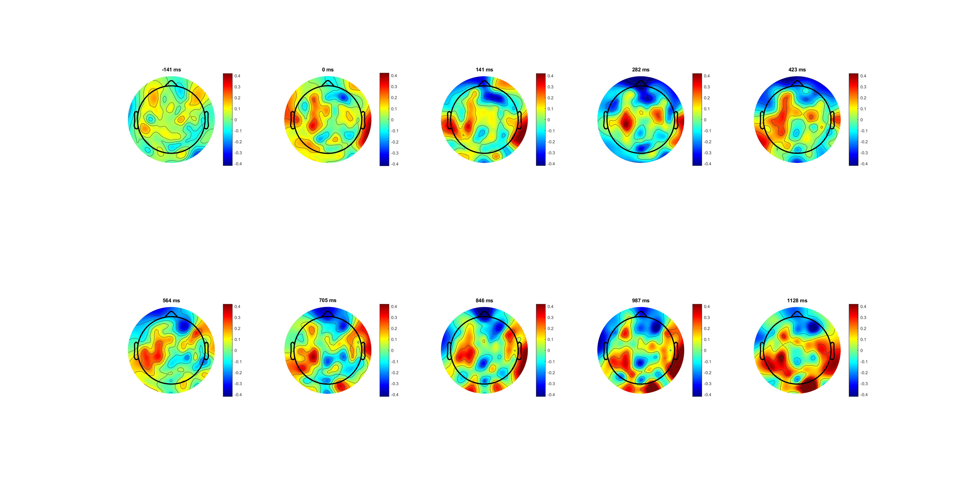
High 0.14 correct lateralisation (L-R) 0.4lim

Slide 10
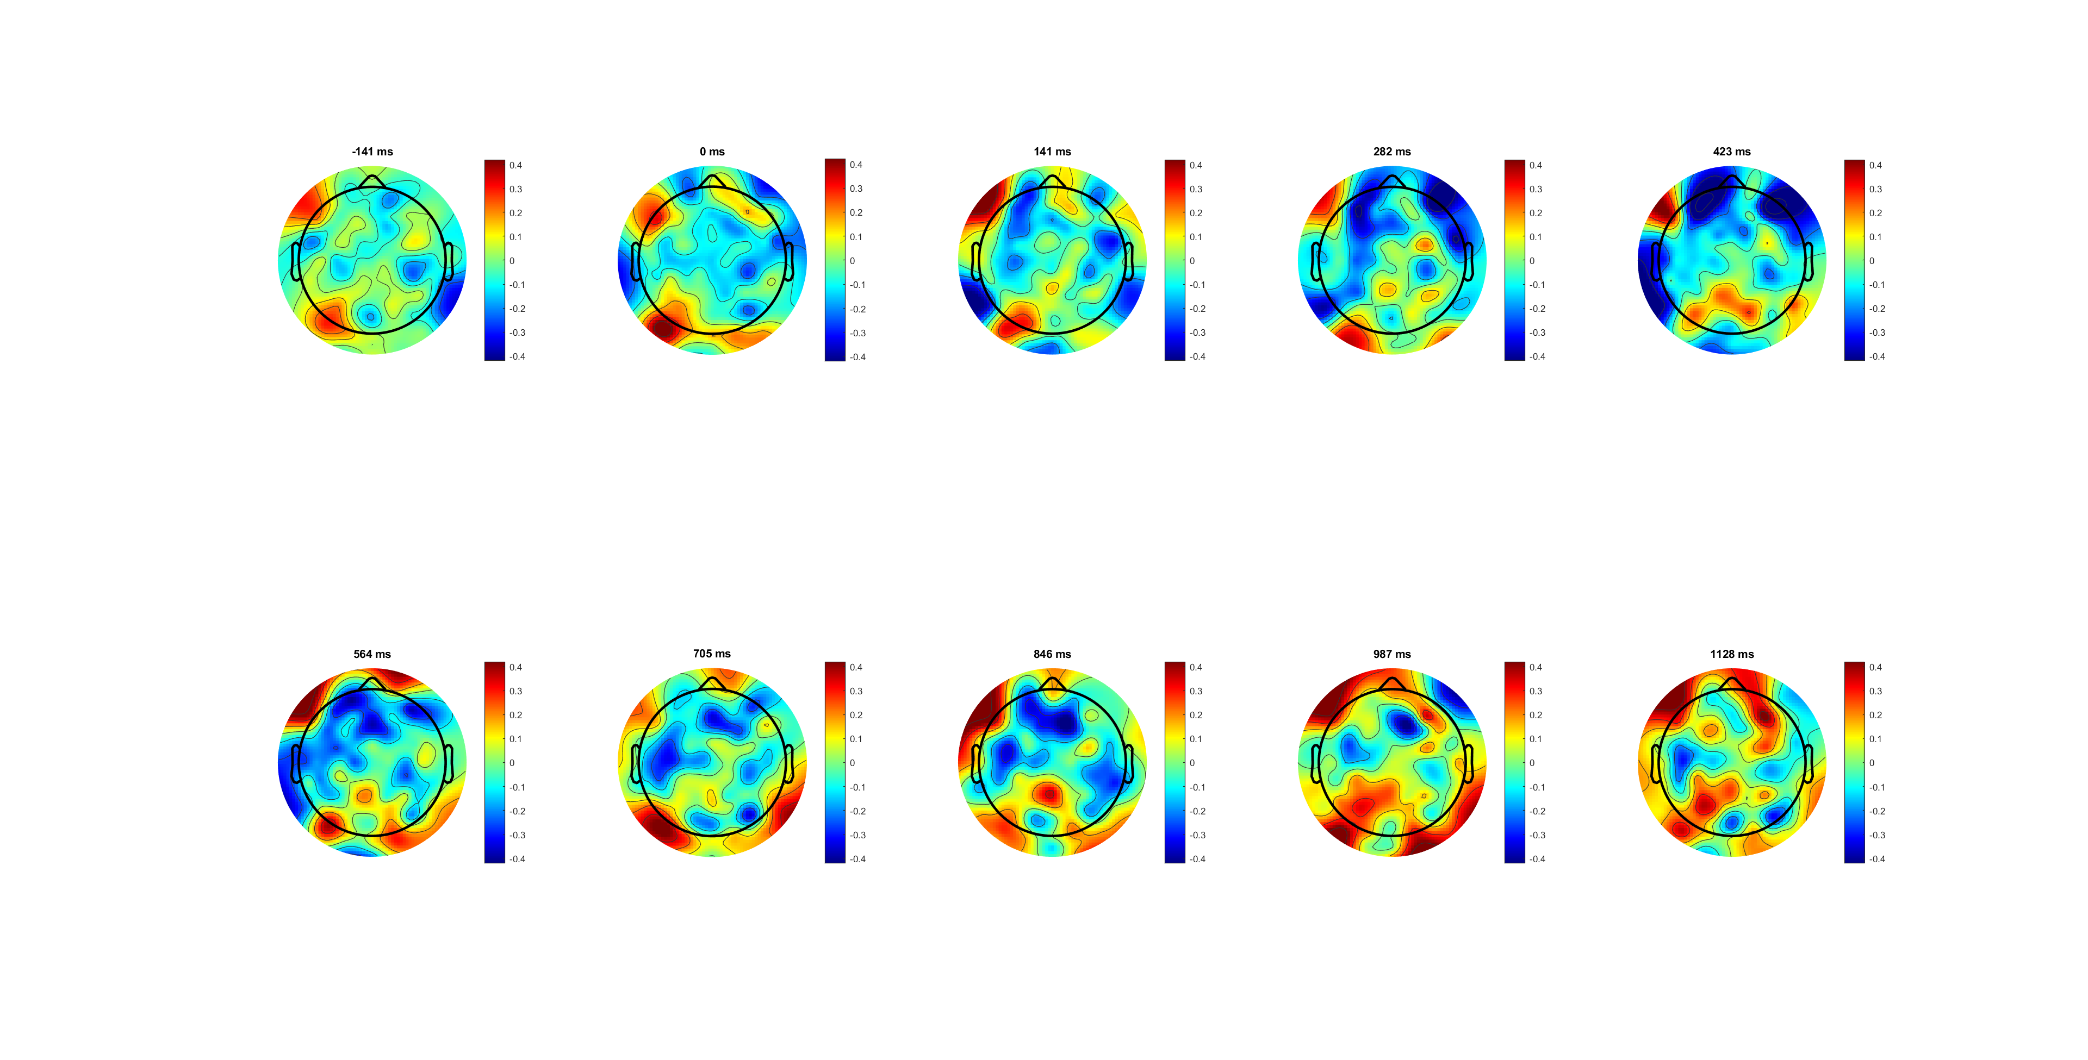
Low 0.07 correct lateralisation (L-R) 0.8lim

Slide 12
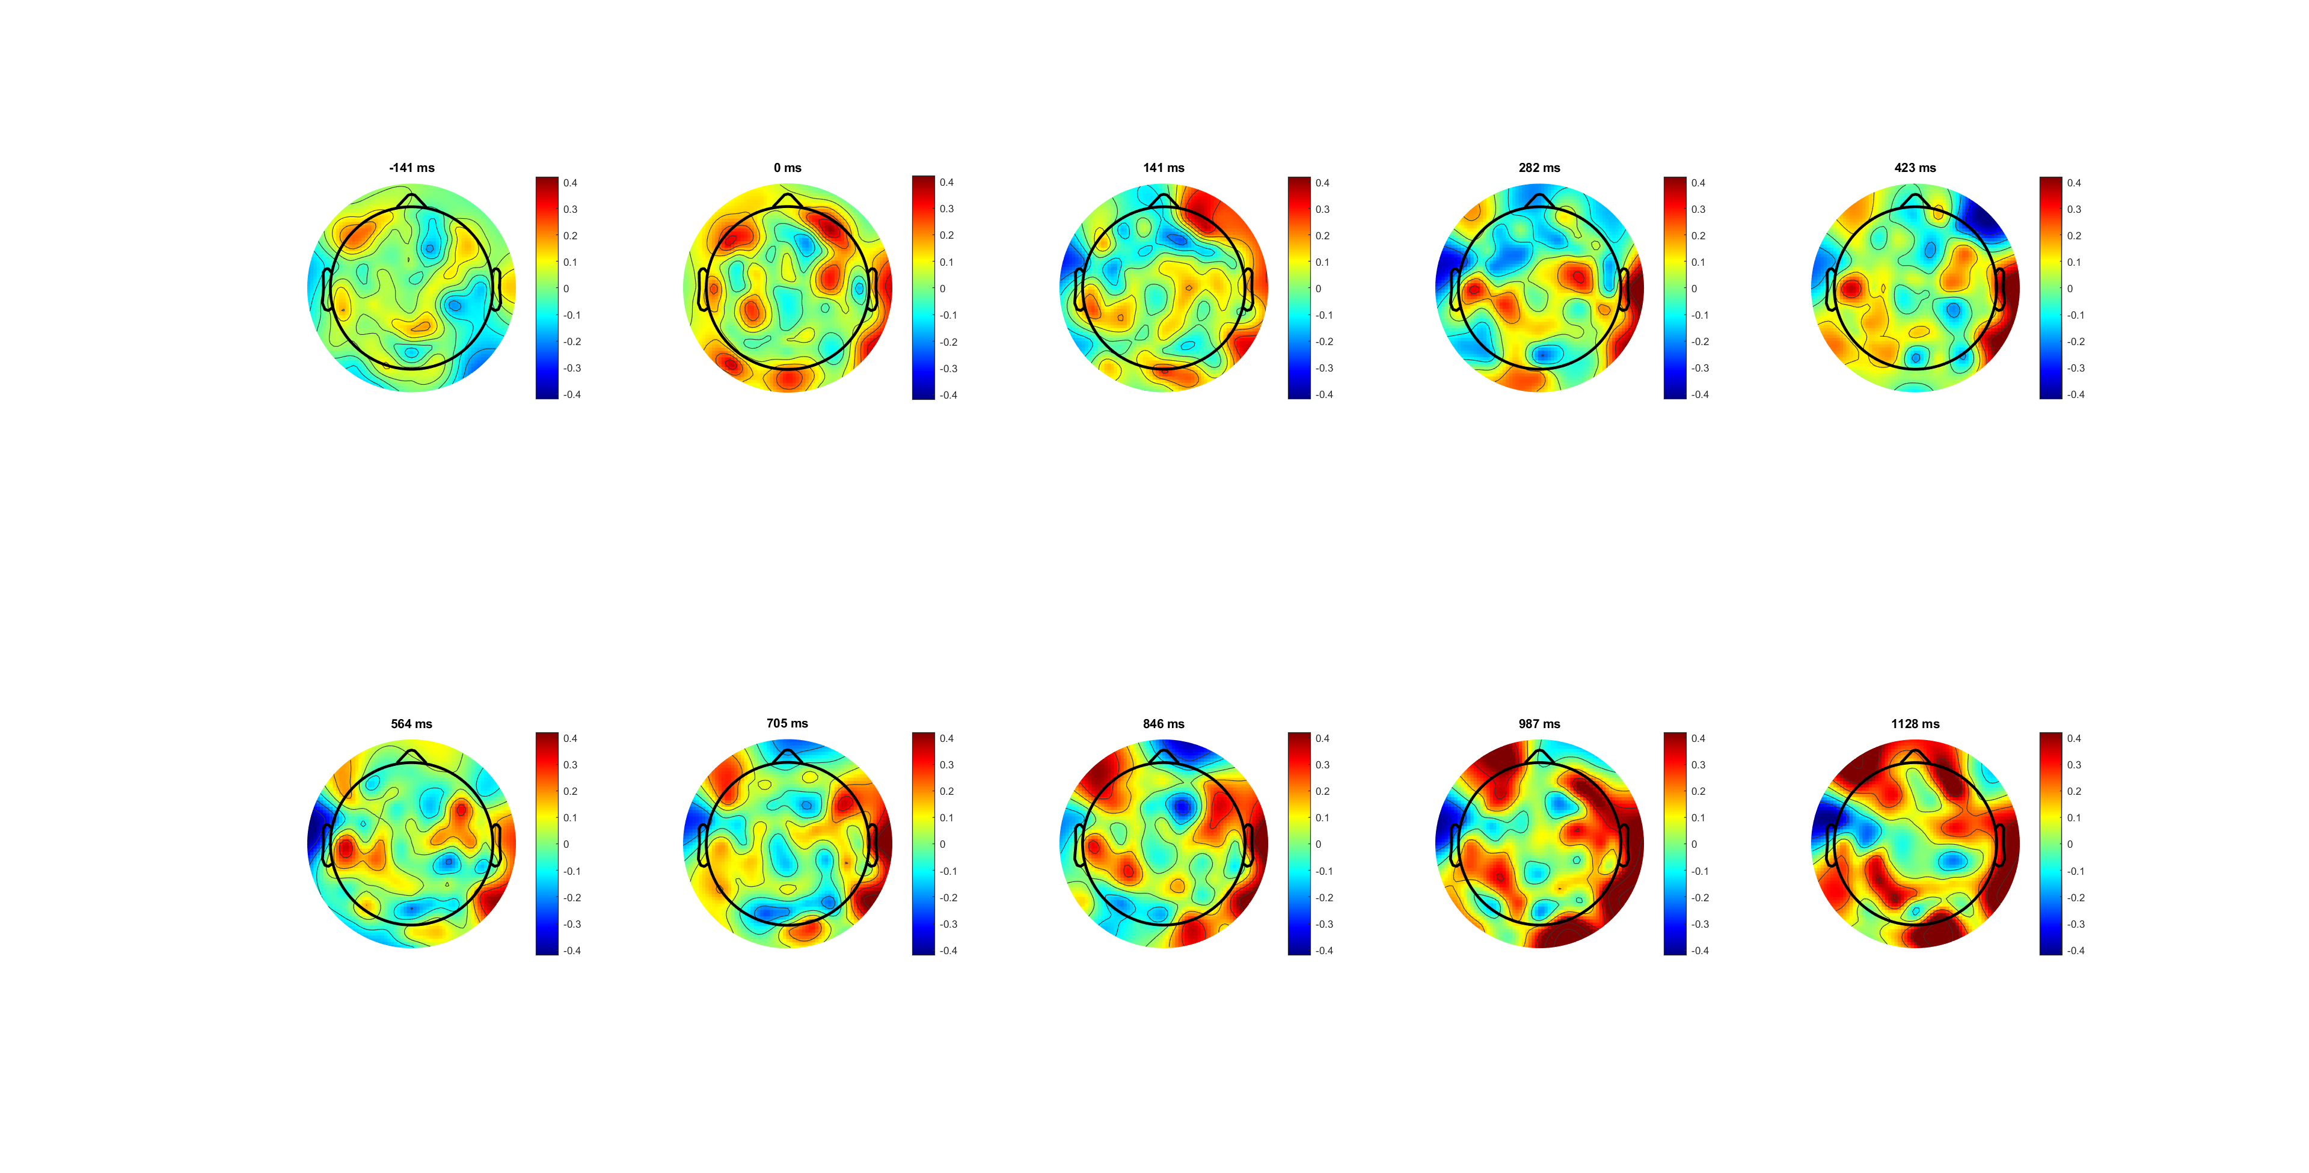
FDI

Slide 13
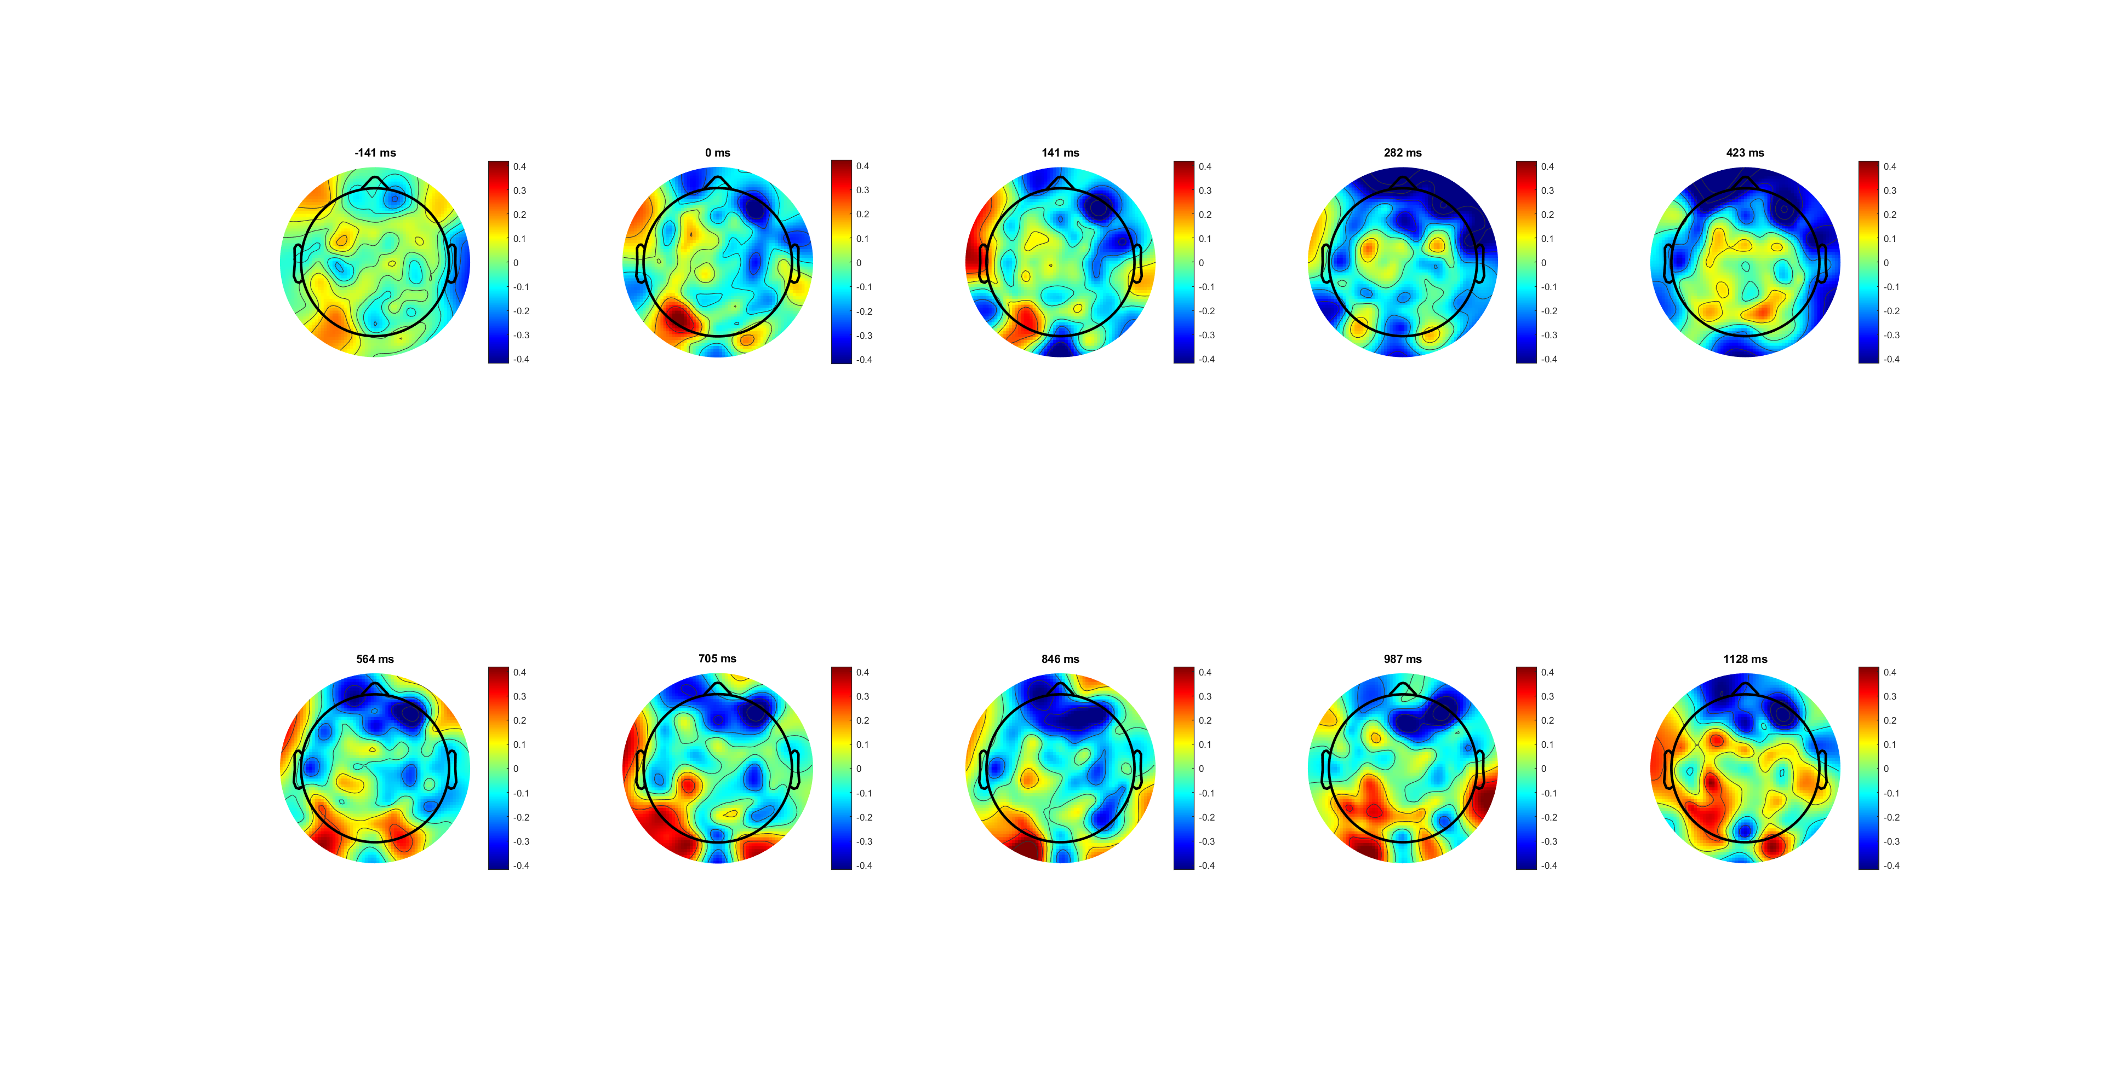
BCP

Slide 14
Different channels for FDI BCP?

